Slide 1

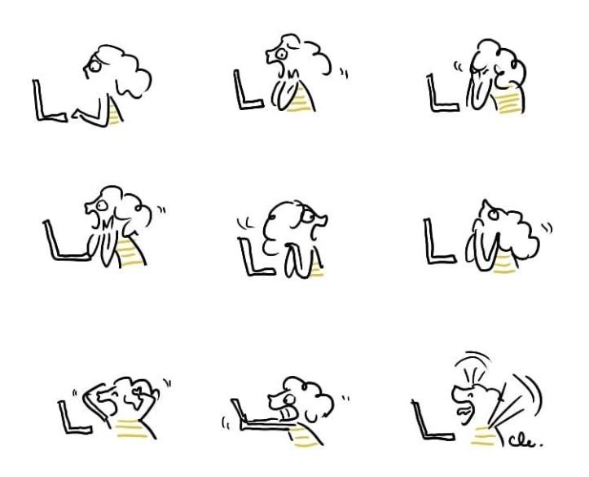
Introduction to UNIX
Useful links and websites
Google
Stack overflow
GitHub
https://www.unixtutorial.org/commands
Clémentine Latron
clemence.fraslin@roslin.ed.ac.uk
@FraslinClemence

Slide 2
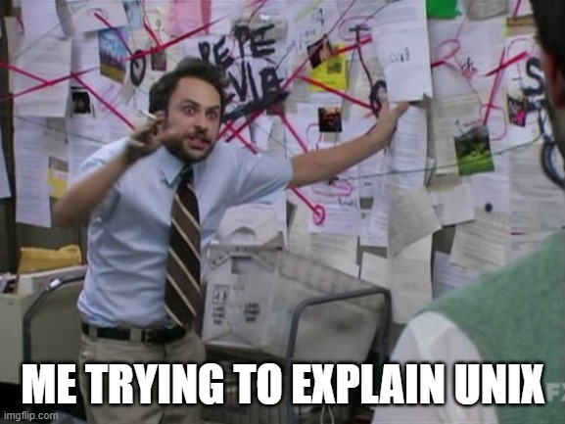
Outline
What is unix and why is it useful?
How to navigate in a unix environment?
How to open/read files
How to create, copy, move, delete a directory or a file
How to manipulate big and complicated files in a easy way
How edit a file
How to submit a job
Tips and Cheat-sheets

Slide 3


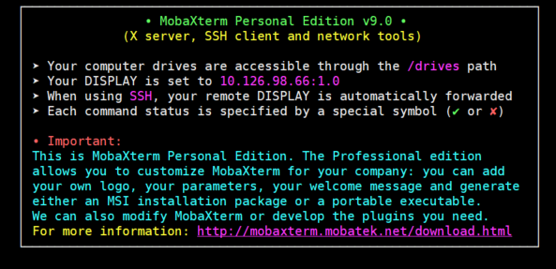
What is UNIX?
Operating system = suite of programs which make a computer work (DOS / Windows) supporting multiple software and multiple users
Created in the 1960’s is coded in C language
Can have a graphical user interface (GUI) similar to Microsoft Windows but usually we use it in a terminal (interface) with operations and command lines interpreted by the shell
Through a console you can access a server (your own computer or a big computer (Eddie in Edinburgh)) using a SSH (secure Shell)
Several version of UNIX (Linux, Solaris, MacOs X … )
You can use client to access shell (MobaXterm / WinSCP / PuTTY /KiTTY …)

Slide 4

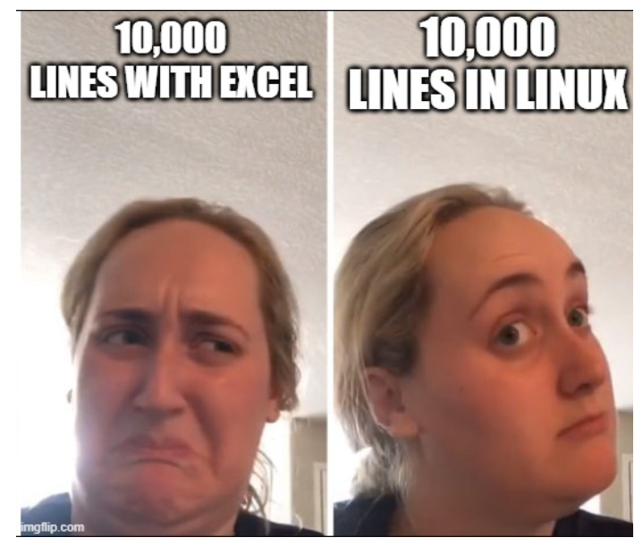
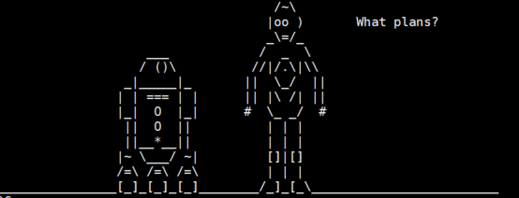
Why do we use UNIX for?
Allows you to run multiple software/programs that are not available / have low performances on windows interface
Gives you direct control of the computer
Powerful to manage big data (thousands of lines that would make Excel crash)

Slide 5
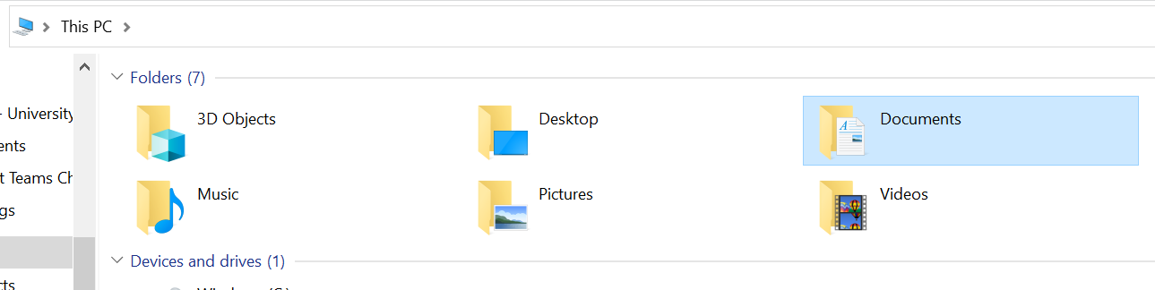
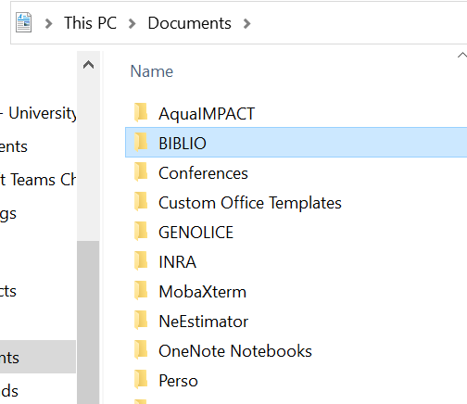
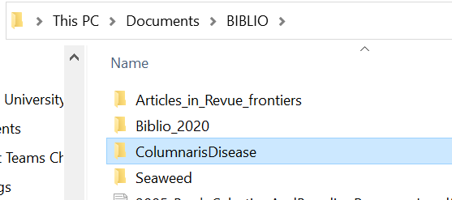
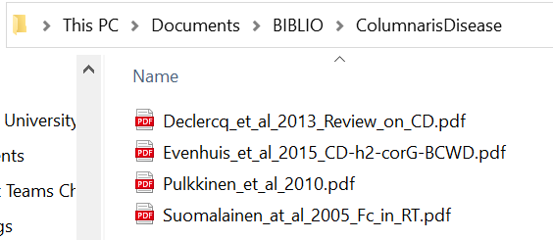
Window’s environment
PATH

Slide 6
UNIX environment
/home
Documents
Music
Pictures
Project1
BIBLIO
GRINNAQUA
Project2
Edinburgh
Porto
Paris
RNAseq
GWAS
Trout
Salmon
RNAseq
GWAS
GS
Hierarchical structure (inverted tree)
Directory (=folder)
Files
Path (=directory address)

Slide 7
/home
Documents
Music
Pictures
Project1
BIBLIO
GRINNAQUA
Project2
Edinburgh
Porto
Paris
GWAS
RNAseq
Trout
Salmon
RNAseq
QTL
GS
From home to Porto
From Porto to RNAseq
From home to GS
From Porto to Edinburgh
/home/Picture/Edinburgh
or
../Edinburgh
/home/Pictures/Porto
/home/Documents/GRINNAQUA/RNAseq
or
../../Documents/GRINNAQUA/RNAseq
/home/Documents/Project1/Salmon/GS

Slide 8
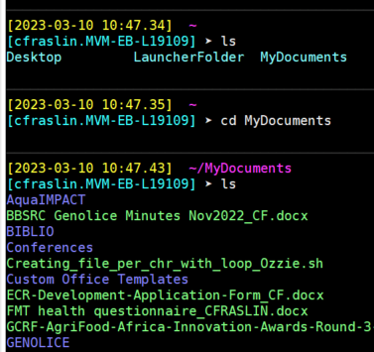
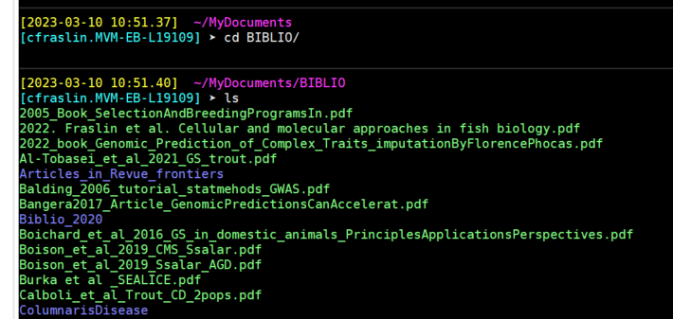
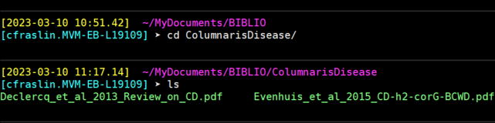
In a UNIX environment
Window’s environment
PATH

Slide 9
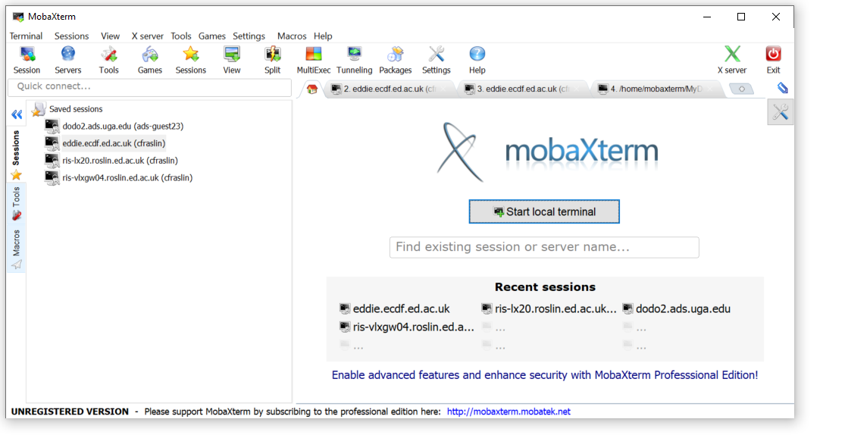
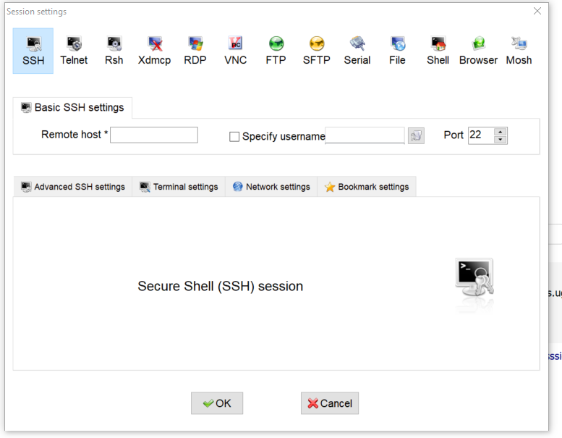
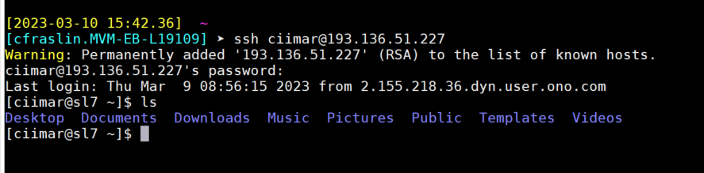
Starting a UNIX terminal
From a client you open a terminal
To your computer
To a server through an SSH connexion
Type command lines
help

Slide 10
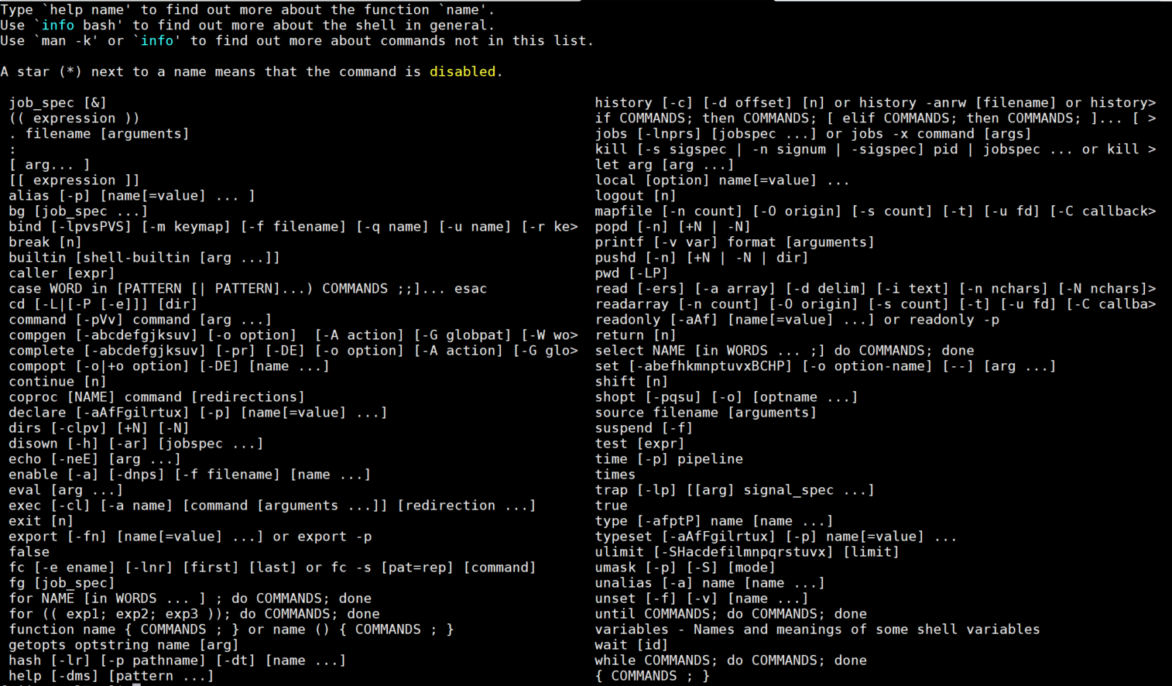
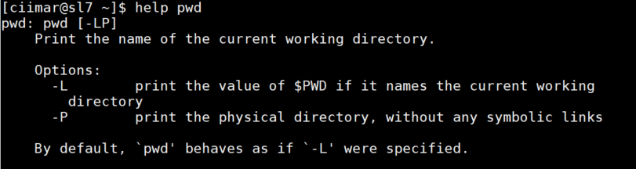

Slide 11
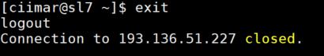
Starting a UNIX terminal
From a client you open a terminal
To your computer
To a server through an SSH connexion
Type command lines
help
exit

Slide 12
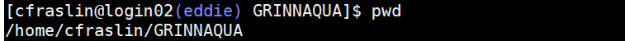
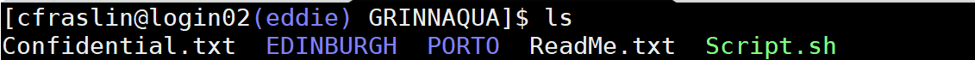
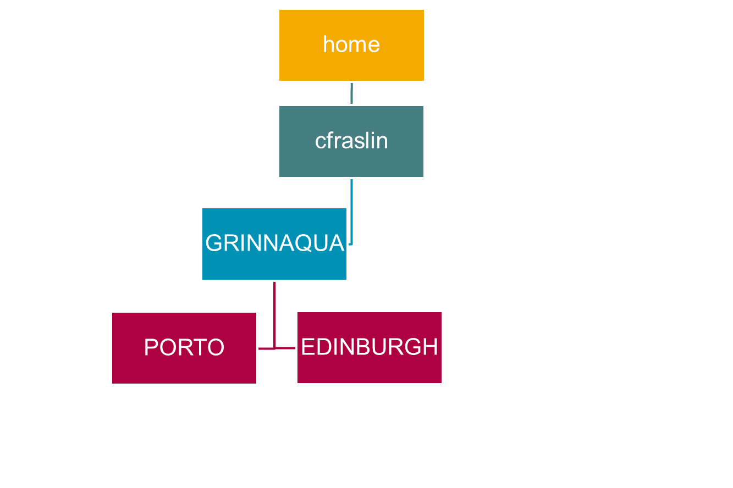
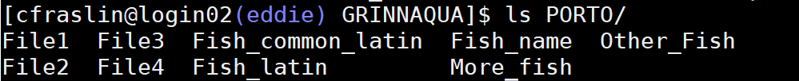
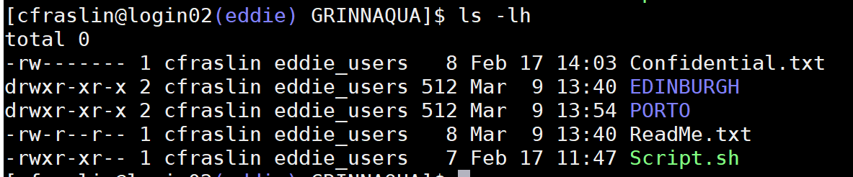
How to navigate in a UNIX environment
pwd → print the path to the current directory
/home/username/DirecortyName
ls → list what is in the directory you are in
ls /PATH/ → list what is in the directory at the end of the path
ls -lh → list + information on permissions, who created the file, the size of the files (in human readable format) and date of creation/modification

Slide 13
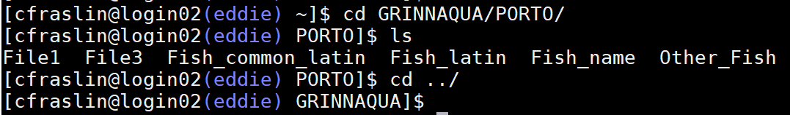
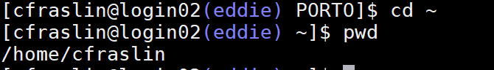
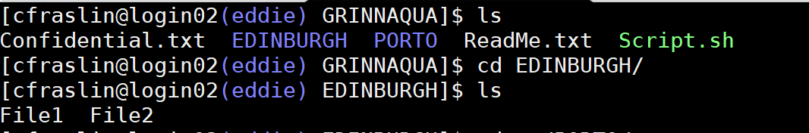

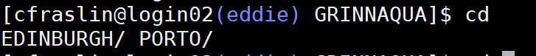
How to navigate in a UNIX environment
cd → to move between directories
cd ../ → go back to the parent
directory ( cd ../../../)
cd ~ → equivalent to cd /home/username/
cd path/ → move to path
Auto completion using tab for file and directories names
[tab]
[tab]

Slide 14
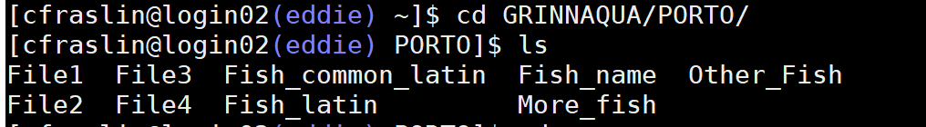
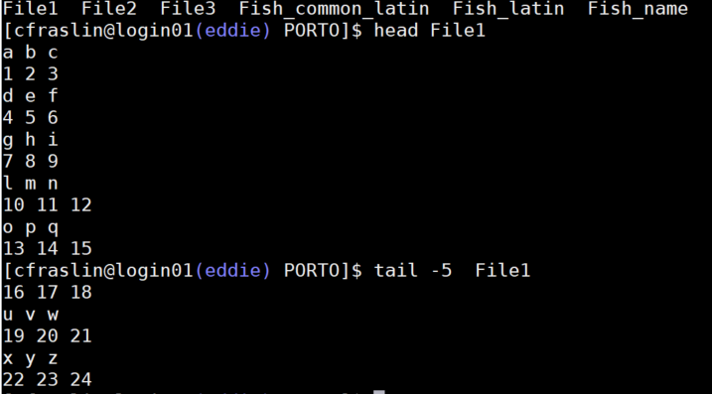
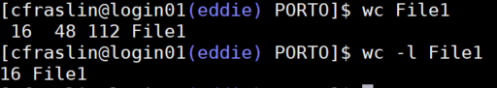
Useful command to read files
head File1 → print the first 10 lines of File1
head -20 File1 → print the first 20 lines of File1
tail File1 → print the last 10 lines of File1
wc File1 → counts the number of lines / words / bytes of File1
wc –l File1→ count the number of lines in File1

Slide 15
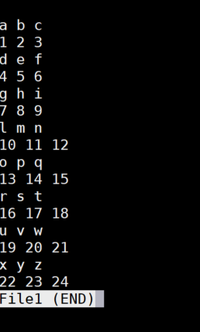
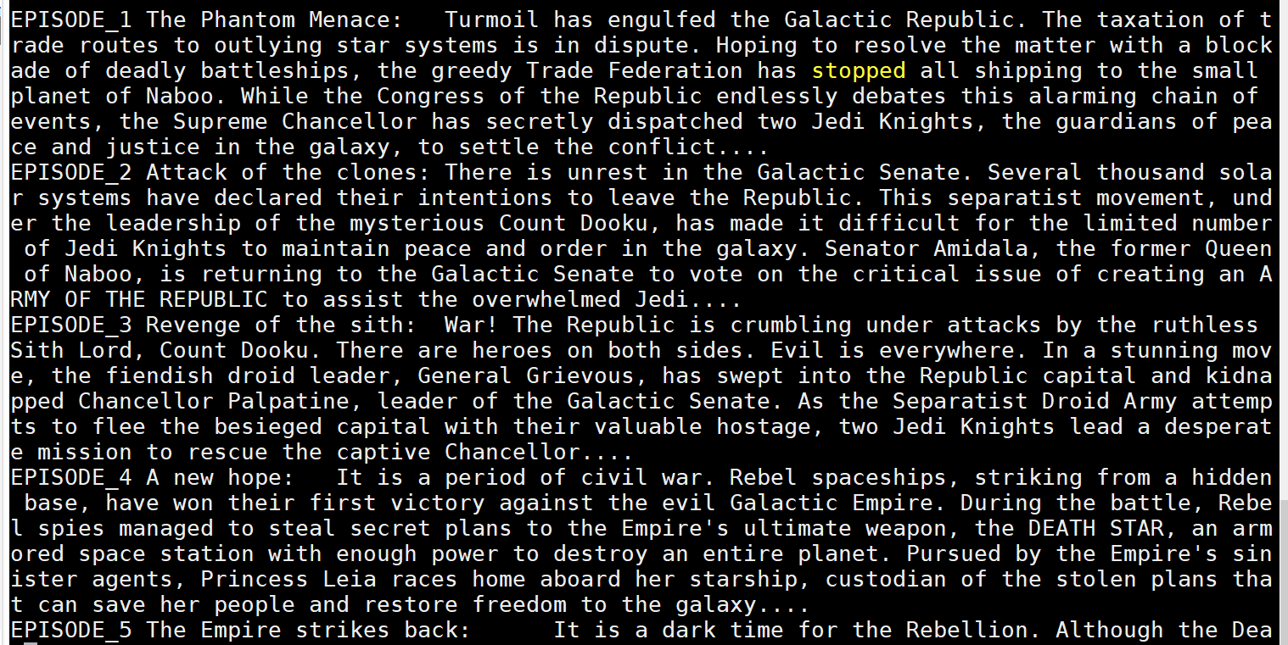
Useful command to read files
less File1 → Shows on your screen the content of File1 page-by-page. To escape a less command type q
less -S long.txt → Shows on your screen the content of File1 line-by-line. Very useful for long lines (genotype files for eg.)
[q]
[q]

Slide 16
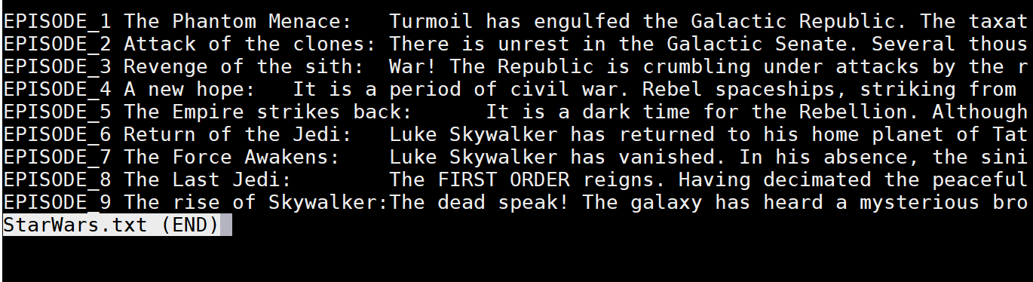
Useful command to read files
less File1 → Shows on your screen the content of File1 page-by-page. To escape a less command type q
less -S long.txt → Shows on your screen the content of File1 line-by-line. Very useful for long lines (genotype files for eg.)
[q]
[q]

Slide 17
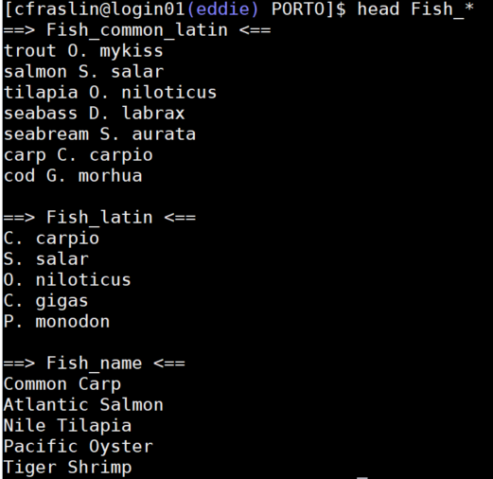
Useful command to read files
head Fish_* → print the first 10 lines of all files
starting in Fish_
less File1 → Shows on your screen the content of File1 page-by-page. To escape a less command type q
less -S File1 → Shows on your screen the content of File1 line-by-line. Very useful for long lines (genotype files for eg.)
[q]

Slide 18
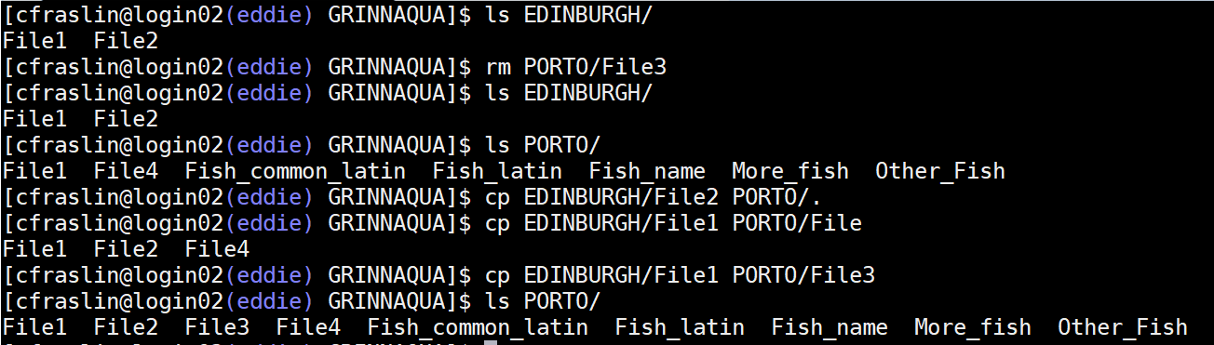
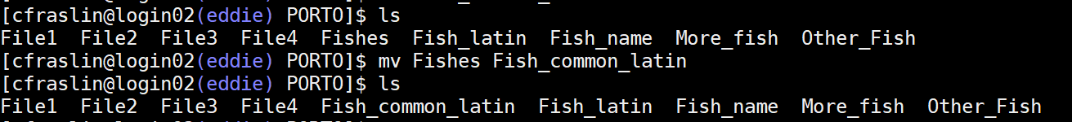
Copy, create, remove files and directories
cp to copy and paste
cp → copy files or cp –r → copy directory
(-r recursive: apply to everything after the command)
Copy with the same name in a new folder
cp path/FileName NewPath/.
Good practice: Copy and “rename”
cp path/FileName NewPath/FileName2
mv → move a file or directory (cut and paste)
mv Directory /path/Directory
mv → rename files/directory
mv FileName1 NewFileName

Slide 19
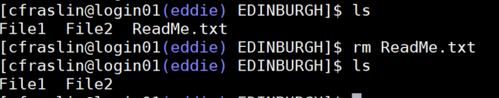
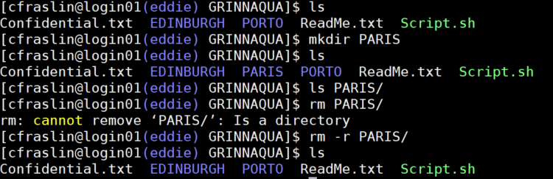
Copy, create, remove files and directories
rm → delete files or directory
rm FileName
rm –r DirectoryName (-r recursive this directory and all the subdirectories)
rm File* (delete all files starting by File)
rm *.pdf (delete all the files ending in pdf)
→ Use with caution the rm *
mkdir → make new directory
mkdir NewDirectoryName
rmdir → remove directory
rmdir DirectoryName

Slide 20
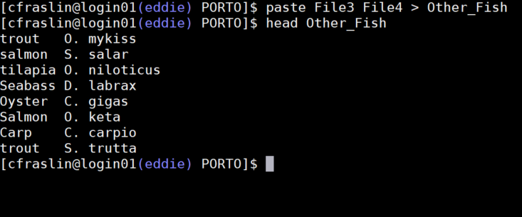
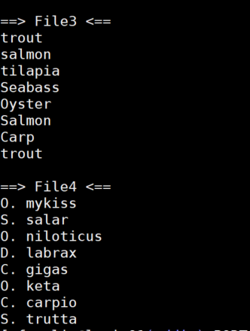
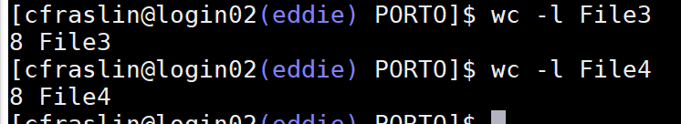
Text processing tools
paste → paste lines of two files

Slide 21
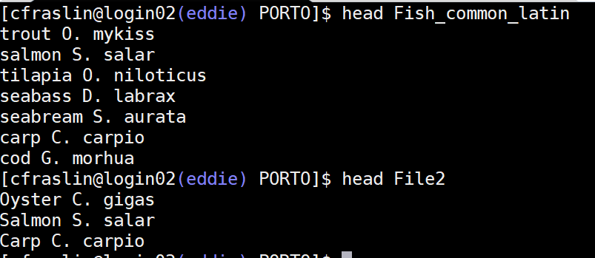
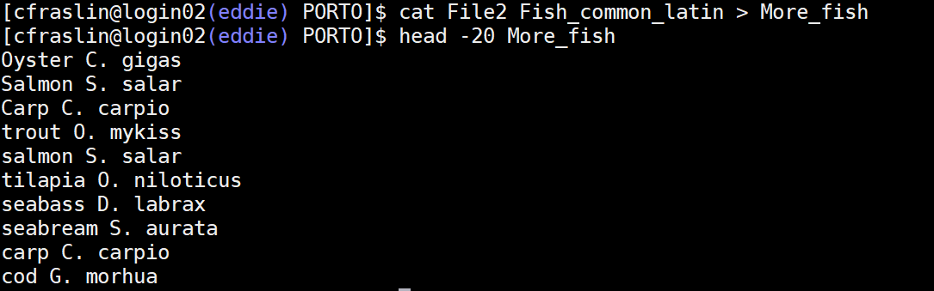
Text processing tools
cat File1 File2 > File3 → concatenates File2 after File1 in a new file File3

Slide 22
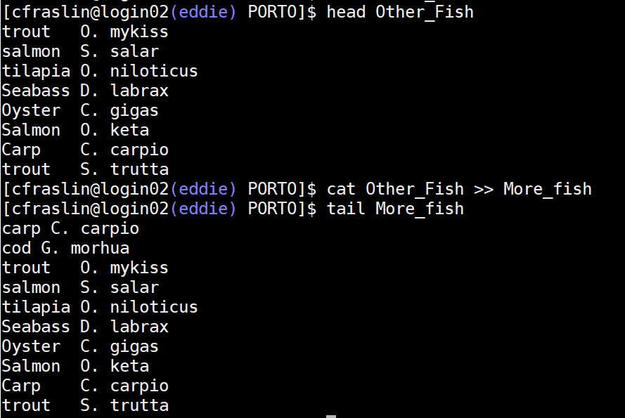
Text processing tools
cat File1 File2 > File3 → concatenates File2 after File1 in a new file File3
cat File4 >> File3 → Add the content of File4 in File3
`>` → create and if exist replace `>>` → add at the end

Slide 23
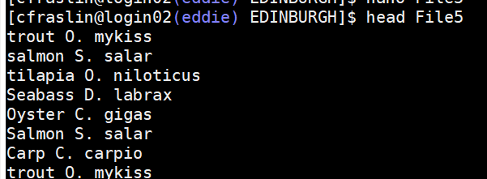

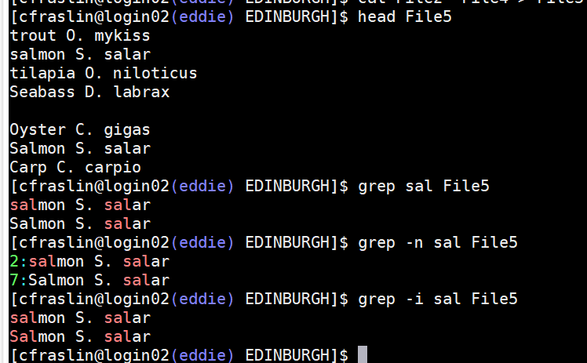
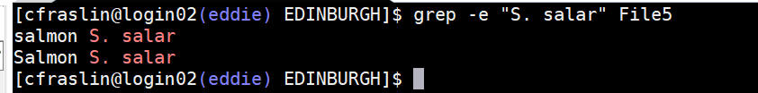
Text processing tools
grep pattern File → finds lines that contains the pattern in File. (zgrep for gzip files)
-n for the line number
-i for case insensitive
-c to count the number of lines
-e to find a pattern with space
-v all lines that do NOT match the pattern

Slide 24
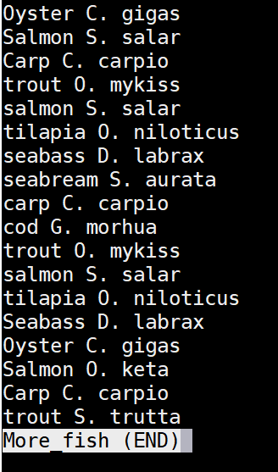
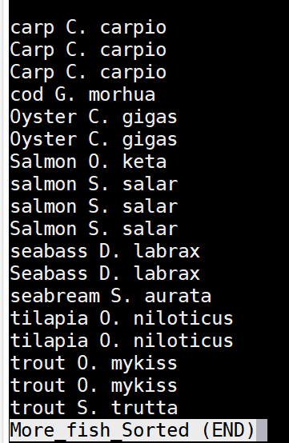
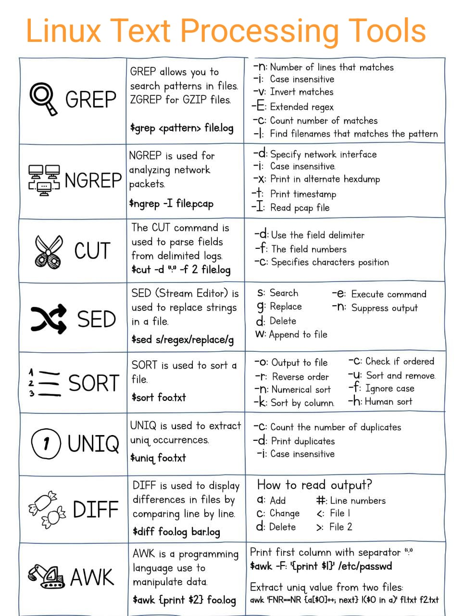

Text processing tools
sort → sort a file
Alphabetically, on column 1

Slide 25




Text processing tools
uniq → retains unique lines on a sorted file
Case sensitive

Slide 26



Create and edit a file
Create a file:
touch filename
echo “start writing” > filename

Slide 27



Read and edit a file
https://www.nano-editor.org/docs.php
nano
geany
nano
Vi
xedit
nedit
Using your client (MobaXterm)

Slide 28


Submit jobs
In an interactive environment you can submit using ./
./job_script.sh
The qsub command scan you script.sh file line by line and execute the commands inside
qsub job_script.sh
See the status of the jobs you submitted in a qsub
qstat
Delete a job
qdel job_id
Tips: if you run a job in an interactive session and you want to keep a record of the ouptut use the command tee to print what appears on the screen in a file. | is called a pipe
./job_script.sh | tee job.lst

Slide 29

To exit a program
exit → exit a session and many programs
quit or q → quit many programs
crtl d or crtl x → end of file
crtl c → interrupt a program
crtl z → suspend a program

Slide 30

Tips and other useful commands
Auto completion → [TAB]
history → show history of previous command
Previous commands → top arrow
df → present statistics (including free disk space) on all file
du –k → Shows space used in the current directory and its subdirectories
dos2unix → format a file for unix (if created on windows)
expand → replace TAB with spaces
clear → clears the terminal (does not clear the history)
chmod → change permission of the file.

Slide 31


Tips and other useful commands
File permissions
chmod → change permission of the file.
chmod u+x file to give permission to execute a file *
User
Group’s member
Other (all)
r = read
w = write
x = execute
*Change permission using numbers
4 read
2 write
1 execute
chmod 777 file → give all permissions to the file

Slide 32



Cheat sheets
https://cheatography.com/davechild/cheat-sheets/linux-command-line/

Slide 33

Cheat sheets
https://cheatography.com/davechild/cheat-sheets/linux-command-line/
https://www.guru99.com/linux-commands-cheat-sheet.html
Google

Slide 34




Thank you!

Slide 35

Commands and pipes

Slide 36


Slide 37

Create a file
touch filename
echo “start writing” > filename

